Slide 1
Topics
Forecast
Forecast Errors
Conditional and Unconditional Forecasts
Forecast Intervals

Slide 2
ARIMA - Identification
Identification of the most appropriate model is the most important part of the process, where it becomes as much ‘art’ as ‘science’.
The first step is to determine if the series is stationary, If it is not stationary it needs to be first-differenced.
(it may need to be differenced again to induce stationarity. Or for that matter consider log/ power transforms, if variance non stationary)
The next stage is to determine the p and q in the ARIMA (p, d, q) model (the d refers to how many times the data needs to be differenced to produce a stationary series)

Slide 3
Identification (p and q)
To determine the appropriate lag structure in the AR part of the model, the PACF is used, where the number of non-zero points of the PACF determine where the AR lags need to be included.
To determine the MA lag structure, the ACF is used, again the non-zero points suggest where the lags should be included.

Slide 4
Parsimonious Model
The aim is to produce a model that is parsimonious, or as simple as possible.
A parsimonious model is desirable because including irrelevant lags in the model increases the coefficient standard errors.
Models that incorporate large numbers of lags, tend not to forecast well, as they fit data specific features, explaining much of the noise or random features in the data.

Slide 5
Forecasting
One of the most important tests of how well a model performs is how well it forecasts.
To produce dynamic forecasts the model needs to include lags of either the variables or error terms.

Slide 6
Types of Forecast
Forecasts can be either in-sample or out-of-sample forecasts.
In general the out-of sample forecasts are a better test of how well the model works, as the forecast uses data not included in the estimation of the model (discuss difference with X-sectional data).
To conduct out-of-sample forecasts, we need to leave some observations at the end of our sample for this purpose.

Slide 7
Types of Forecasts
A one-step-ahead is a forecast for the next observation only.
A multi-step-ahead forecast is for 1,2,3,…s steps ahead.

Slide 8
Forecast Accuracy
There are a number of measures used:
Mean Absolute Error
Mean Average Prediction Error
Chows test for predictive failure
Theil’s U-statistic (where the forecast is compared to that of a benchmark model)
Root Mean Square Error ( the square root of the MSE)

Slide 9
Measuring Forecast Accuracy
To determine how accurate a forecast is, the simplest method is to plot the forecast against the actual values as a direct comparison
In addition it may be worthwhile to compare the turning points, this is particularly important in finance.
There are a number of methods to determine accuracy of the forecast, often more than one is included in a set of results.

Slide 10
Tests of Forecast Accuracy
Tests of forecast accuracy are based on the difference between the forecast of the variables value at time t and the actual value at time t.
The closer the two are together and the smaller the forecast error, the better the forecast.
There are a variety of statistics measuring this accuracy, mostly based on an average of the errors between the actual and forecast values at time t.

Slide 11
Mean Squared Error (MSE)
The MSE statistic can be defined as:

Slide 12
MSE or FMSE Example
Steps Ahead | Forecast | Actual | Squared Error
1 | 0.1 | 0.15 | 0.0025
2 | 0.25 | 0.20 | 0.0025
3 | 0.5 | 0.40 | 0.01

Slide 13
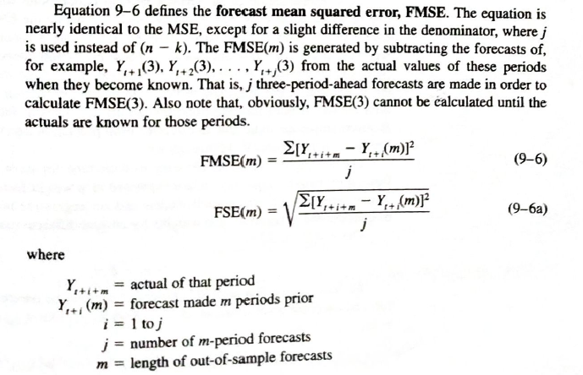
FMSE

Slide 14
Conditional Vs Unconditional forecasts

Slide 15
Conditional Vs Unconditional forecasts
Unconditional – none of the past actual values of the TS influence the forecast.
Conditional – Uses the most recently known actual values (hence more accurate of the two).
NB: Unconditional is actually equivalent to a very long horizon conditional forecast.

Slide 16
Conditional Forecasting
A conditional expectation is one that is taken for time t + 1, conditional upon or given all information available up to and including time t. It is written as:

Slide 17



Illustration of conditional Vs unconditional forecast in the case of AR(1)
AR(1) or ARIMA(1,0,0)can be given by Y_{t} = φ₁Y_{t−1} + e_{t}
The Unconditional forecast of an ARIMA(1,0,0) process is the process mean, no matter how far into the future we forecast (proof refer pp372 text book).
The conditional forecast (pp372)
Expected value of deviations being zero

Slide 18
Financial Loss Functions
When using financial data, it is not always the accuracy of the forecast that matters, very often it is the accuracy of forecasts relating to the sign of future returns or turning points that is important, as this decides if a profit is made.
It is possible to estimate statistics that give the % of correct sign predictions and correct direction change predictions

Slide 19
Correct Sign Predictions (for Fin time series analysis – check for turning points)
The formula for the % of correct sign predictions is as follows:

Slide 20
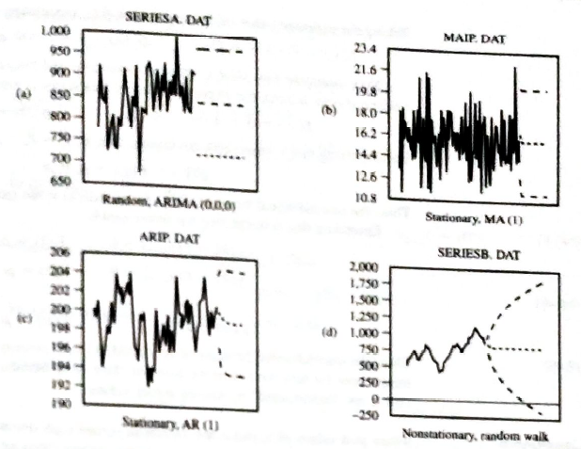
Prediction Interval
A prediction interval is a probability statement of a range of forecasted values assuming that the fitted values is correct and continues into the future
Advantage in ARIMA – define the shape of the forecast prediction intervals. Fig 95% prediction intervals with ARIMA models.
See diff stationary Vs non-stationary series

Slide 21
Prediction Interval
ARIMA models can provide good short-term forecasts.
Most applications we need to know m-period ahead forecasts – here ARIMA models are insightful, contingent upon the validity of the model and the continuation of the past into the future

Slide 22
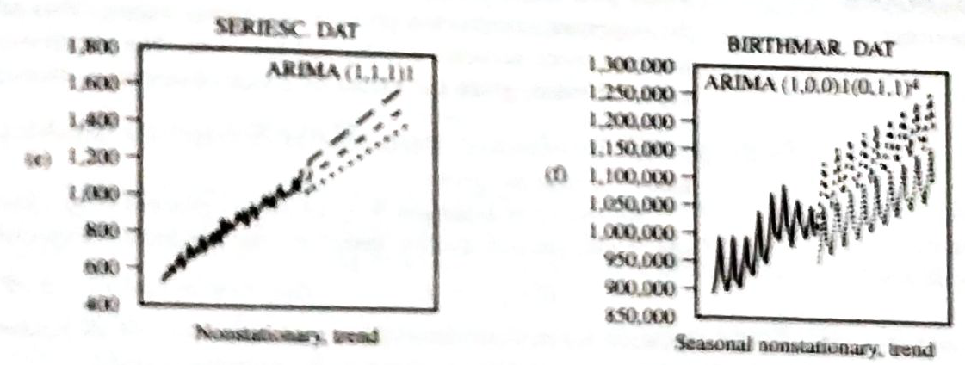
Prediction Intervals - non-stationary series

Slide 23
Conclusion
When using AR models, whether the series is stationary of not, determine how stable it is.
Forecasting of time series is an important measure of how well a model works.
There are many measures of how accurate a forecast is, although all have faults.

Slide 24
Thank You

